Slide 1

Extending the OPD to cover RDM
Defining minimum infrastructure components for RDM and making these visible, discoverable, and comparable.
10/12/2015
Research data spring
Notes:
The key objective for this pilot is to agree - within the community - a list of basic RDM infrastructure components in light of EPSRC's Policy Framework on Research Data and to make this infrastructure more visible and easier to identify.
Possible solution
By extending the Organisational Profile Document (OPD) to consistently list hard and ‘soft’ RDM infrastructure components we will help to make them more visible, machine readable, and discoverable.
What exactly is an Organisation Profile Document (OPD)?
The OPD was developed by Equipment.data at the University of Southampton to help HEIs meet EPSRC's mandate about exposing information on research equipment bought with public funds. The OPD is a simple RDF file which enables equipment data to be made more visible to both humans and machines. There is a small set of mandatory fields that must be completed but great scope to extend the profile with optional information using the LinkingYou vocabulary which was developed by the Jisc-funded Linking You project project at the University of Lincoln. By extending the OPD to consistently list hard and ‘soft’ RDM infrastructure components we hope to make research data management infrastructure components more visible, discoverable, and machine readable.
Why it could work
Builds upon existing infrastructure
Easy to implement solution
HEIs can update and maintain profile locally
Profiles made visible by Equipment.data

Slide 2






Collaborators
Notes:
Glasgow, Leeds and Lancaster participated in Phase 1. In Phase 2, we have also added Cambridge and Bath.

Slide 3
Phase 1 March-July
  Mapped infrastructure components to EPSRC requirements
  Recommended new LinkingYou terms
  Workshop to share draft components
  Period of public consultation
  Tested with 3 HEIs
  Guidance for other HEIs wishing to develop profile
Notes:
Still to do: summary of gaps in service provision identified by working with HEIs.

Slide 4
Phase 2 September- December
  Refined basic RDM profile in light of Jisc R@R shared services RDM infrastructure model
  Developed a set of questions to help HEIs to flesh out their profile to understand how they are delivering infrastructure and services
  Worked with DCC to discuss how the basic profile might feed into sectoral analysis work
  Discussions with Jisc around R@R business case and costing work
  Discussions with CASRAI about proposing basic RDM profile as a standard
Notes:
Late project start. Negotiations with Jisc on the workplan were completed late August so work did not start until September.
Still to do: summary of gaps in service provision identified by working with HEIs.

Slide 5
Basic RDM Infrastructure Profile Components
Means of raising staff awareness of funders’ research data requirements
Research data policy
Strategy or implementation plan for research data services
RDM advice and support services
Active data storage
Persistent identification for datasets
Data register or catalogue
Data access procedures
Secure data access
Institutional publications repository (if it includes research data or metadata)
Data repository for longer term access and preservation
Notes:
Activity:
-Mapped infrastructure components to EPSRC requirements
-Recommended new LinkingYou terms
-Workshop to share draft components
-Period of public consultation
-Tested with 3 HEIs
-Ran workshop exercise around components at IFLA 2015
11 components for basic RDM Infrastructure profile
Means of raising staff awareness of funders’ research data requirements - Provide a link to an information page on funders' policies. This could be internal or external (E.g., DCC's policy overview table)
Research data policy - Provide a link to research data policy or aspirational statement
Strategy or implementation plan for research data services - Provide a link to research data strategy page or roadmap
RDM advice and support services - Provide a link to page describing data management planning guidance and/or support services at this organisation
Active data storage - Provide link(s) to active research data storage information page(s). There may be multiple options at Research Group/School/College/Central levels.
Data register or catalogue - Provide a link to your internal research data registration homepage. This may be provided via the data repository and/or CRIS.
Persistent identification for datasets - Provide a link to any page(s) detailing schemes used to identify digital data items (e.g., DataCite).
Data access procedures - Provide a link to any information provided about research data access.
Secure data access - Provide a link to any information provided about secure data access and governance.
Institutional publications repository (if it includes research data or metadata) - Provide a link to your institutional repository homepage
Data repository for longer term access and preservation - Provide a link to your research data repository homepage. This may be an extension of your publications repository, a separate data repository or a pointer to an external data repository service (E.g., Zenodo).

Slide 6
New Linking You Terms
lyou:research-funders-policies<URL>
lyou:research-data-policy<URL>
lyou:about-strategy<URL>
lyou:research-data-management-planning<URL>
lyou:research-data-active-storage <URL>
lyou:research-data-catalogue <URL>
lyou:research-data-item-identifier-scheme-homepage<URL>
lyou:research-data-access<URL>
lyou:research-data-secure-access<URL>
lyou:research-publications-repository<URL>
lyou:research-data-repository-long term<URL>
Notes:
We have developed a Research Data Management category with the following terms. Only existing term used is lyou:about-strategy but feedback suggests that we should make this specific to research data as well.
Ongoing refinement and finalisation of terms based on work with HEIs.

Slide 7
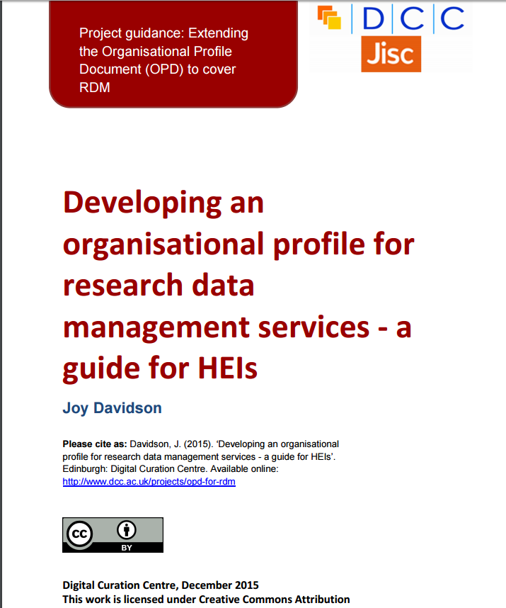

Guides for HEIs
http://www.dcc.ac.uk/projects/opd-for-rdm
http://equipment.data.ac.uk/guides
Notes:
General guidance released on the organisational profile document by equipment.data;
HEI guide for developing RDM profile from DCC.

Slide 8
RDM profile worksheet with Linking You terms
Research Data Management Profile
RDM profile component | Record HEI Link - insert your URLs in the space provided (replace the red text) | Guidance
Means of raising staff awareness of funders’ research data requirements | lyou:research-data-funders-policies<URL> | Provide a link to an information page on funders' policies. This could be internal or external (E.g., DCC's policy overview table)
Research data policy | lyou:research-data-policy<URL> | Provide a link to research data policy or aspirational statement
Strategy or implementation plan for research data services | lyou:about-strategy<URL> | Provide a link to research data strategy page or roadmap
RDM advice and support services | lyou:research-data-management-planning<URL> | Provide a link to page describing data management planning guidance and/or support services at this organisation
Active data storage | lyou:research-active-data-storage<URL> | Provide link(s) to active research data storage information page(s). There may be multiple options at Research Group/School/College/Central levels.
Data register or catalogue | lyou:research-data-catalogue<URL> | Provide a link to your internal research data registration homepage. This may be provided via the data repository and/or CRIS.
Persistent identification for datasets | lyou:research-data-item-identifier-scheme-homepage<URL> | Provide a link to any page(s) detailing schemes used to identify digital data items (e.g., DataCite).
Data access procedures | lyou:research-data-access<URL> | Provide a link to any information provided about research data access.
Secure data access | lyou:research-data-secure-access<URL> | Provide a link to any information provided about secure data access and governance.
Institutional publications repository (if it includes research data or metadata) | lyou:research-publications-repository<URL> | Provide a link to your institutional repository homepage
Data repository for longer term access and preservation | lyou:research-data-repository-long term<URL> | Provide a link to your research data repository homepage. This may be an extension of your publications repository, a separate data repository or a pointer to an external data repository service (E.g., Zenodo).
http://www.dcc.ac.uk/webfm_send/2077
Notes:
Potential for us to easily produce these as an outcome of DCC Research Infrastructure and Support Evaluation (new supported assessment approach that will replace DCC Institutional Engagement programme).

Slide 9
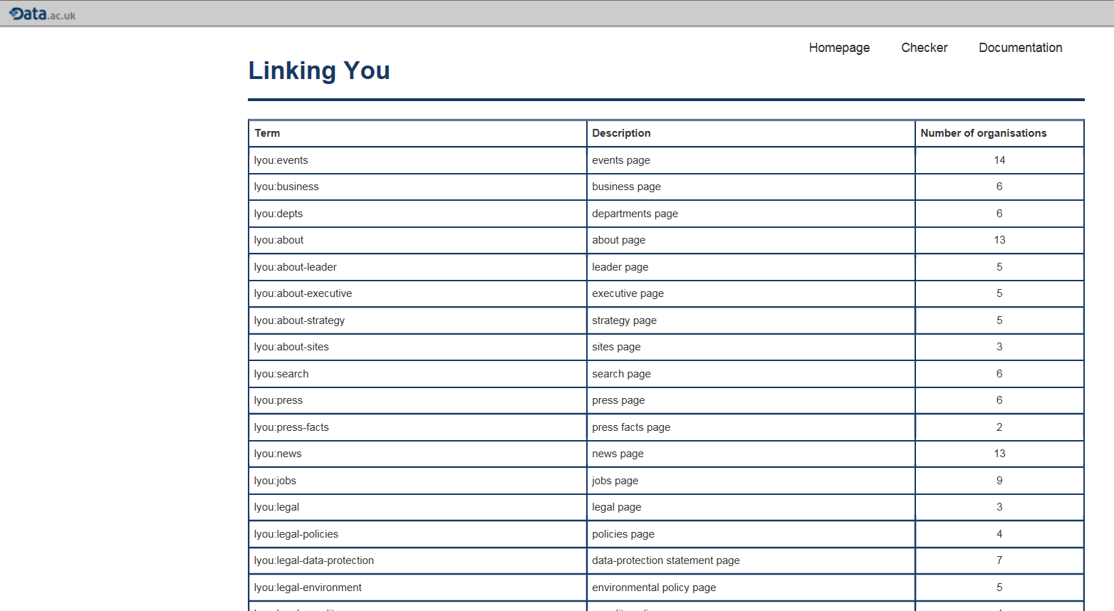
OPD - Linking You Filter
http://opd.data.ac.uk/dataset/linkingyou
Notes:
A growing number of universities are producing auto-discoverable profiles which include the "Linking You" terms. <http://opd.data.ac.uk/docs/key-pages>
Andrew Milsted from Equipment.data team developed a filter to allow Linking You terms to be displayed collectively rather than people having to pull up an individual OPD to view the Linking You data. Beside each term you can see a description of the term plus the number of organisations that have provided that information in their OPDs.

Slide 10
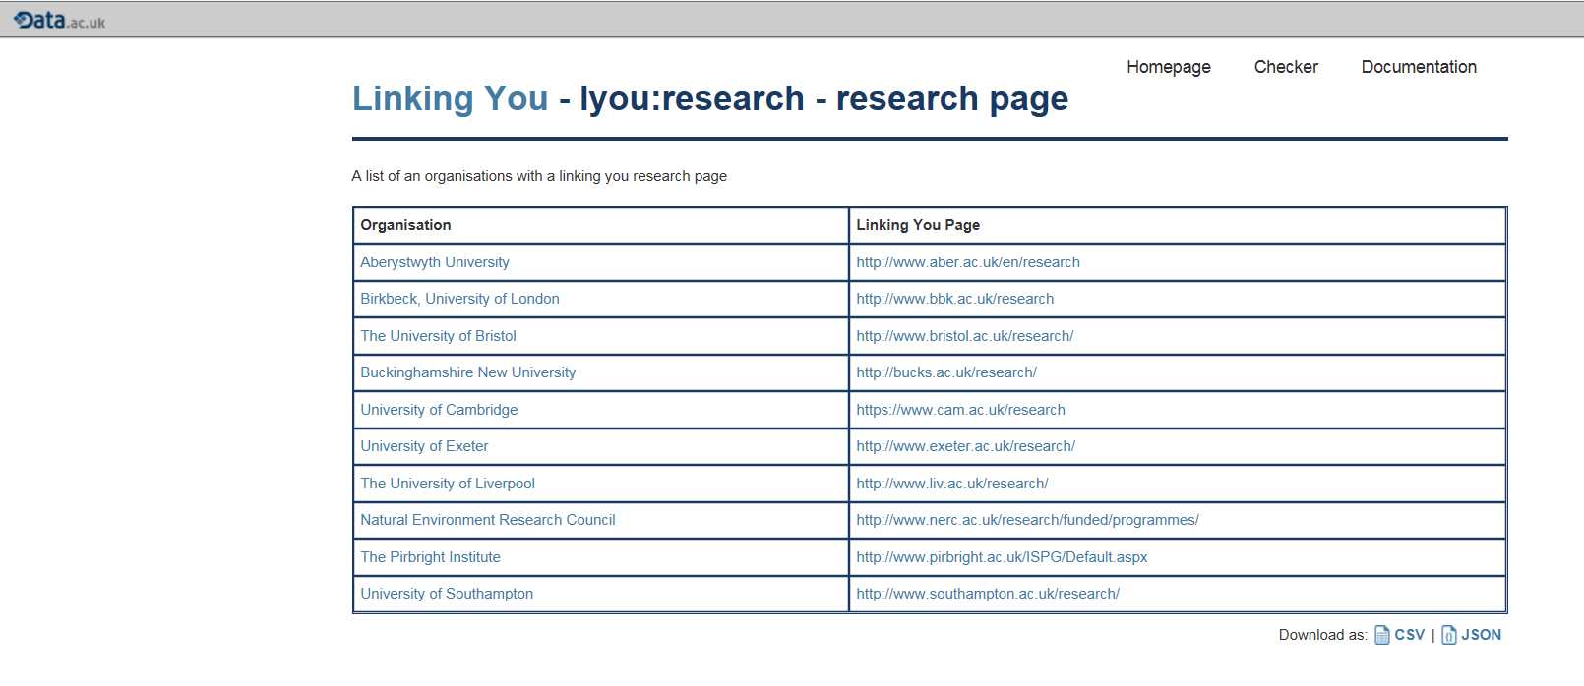
OPD - Linking You Filter
Notes:
If you click on the Linking You term Research Page – you would be taken to this page which allows you to see which institutions have provided information and to be able to click through to the page.
We want to further refine this functionality to enable people to view one category (e.g., Research Data Management) rather than having to browse through each term individually. This would be further developed in Phase 3.

Slide 11
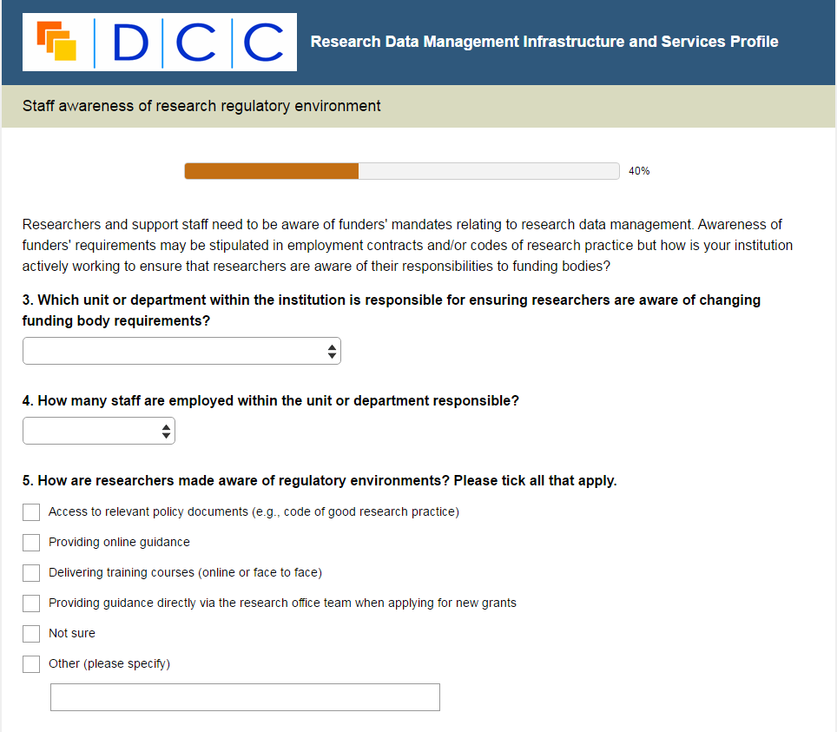
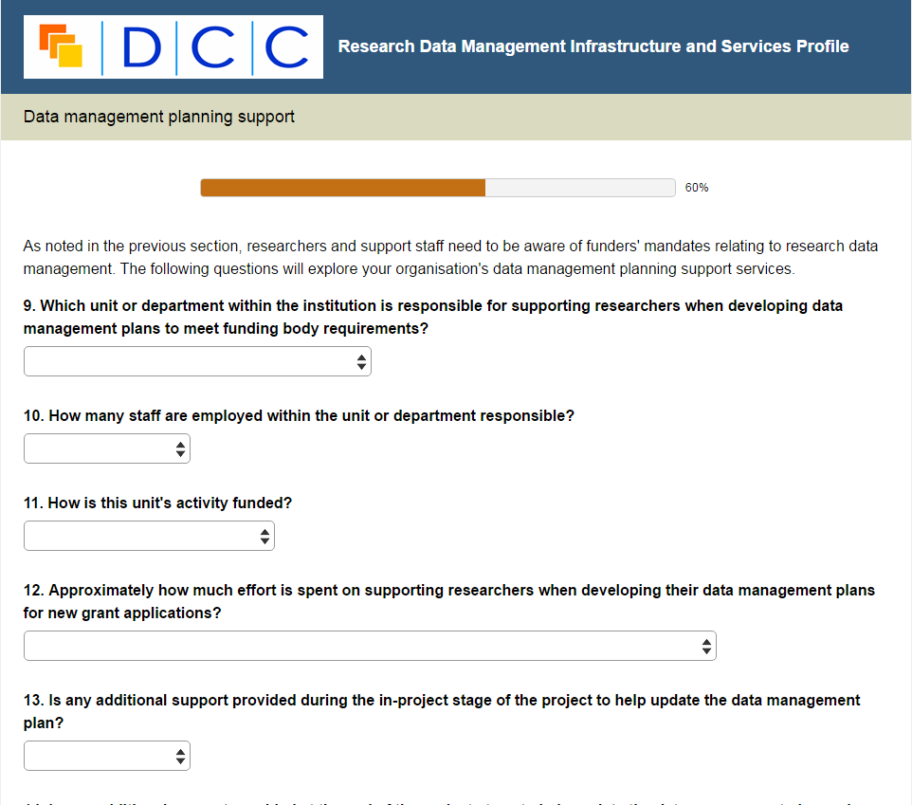
Infrastructure delivery survey
Notes:
If you click on the Linking You term Research Page – you would be taken to this page which allows you to see which institutions have provided information and to be able to click through to the page.
We want to further refine this functionality to enable people to view one category (e.g., Research Data Management) rather than having to browse through each term individually. This would be further developed in Phase 3.

Slide 12
Benefits
Easy to implement solution building upon existing infrastructure
Starting point for comparing institutional approaches more effectively and consistently
Potential for profiles to be used more widely and for definition of new profiles
Notes:
Technology, effort and costs for different approaches; shared services; efficiencies; classify guidance and training
Possibility to use OPD technology to begin to share effort across HEI by aggregating sub-profiles held and maintained across HEI rather than one unit maintaining the organisational profile (e.g., the equipment profile not likely to be maintained by the same group that maintain the RDM profile).

Slide 13
Sustainability
  HEIs can update and maintain profile locally
  Profiles made visible by Equipment.data
  OPD and checker code freely available on Github

Slide 14
Phase 3
  Investigate possible metrics for RDM service delivery and operations to help HEIs develop better business cases and sustain investment
  Further work to improve search function of Linking You terms by sub-profile (e.g., RDM)
  Submit standard to CASRAI once UK chapter becomes active
Notes:
Move from providing evidence of basic infrastructure to some assessment of quality or levels of service
Not possible to develop metrics for all components in time available, but Phase three will aim to examine possible metrics for three of the basic RDM components:
1) York/Hull investigating metrics around digital preservation
2) Lancaster looking at metrics around data management planning from the research office perspective
3) DCC looking at RDM support and guidance metrics

Slide 15
Contact
Thanks – any questions?
joy.davidson@glasgow.ac.uk
@jd162a
www.dcc.ac.uk

